Slide 1
CS 4530 & CS 5500
Software Engineering
Lecture 10.3: Deployment Infrastructure
Jonathan Bell, John Boyland, Mitch Wand
Khoury College of Computer Sciences © 2021, released under CC BY-SA

Slide 2
Learning Objectives for this Lesson
By the end of this lesson, you should be able to…
Describe the difference between key deployment container abstractions and their role in modern software
Compare the performance and cost of different deployment infrastructures, including platform-as-a-service

Slide 3


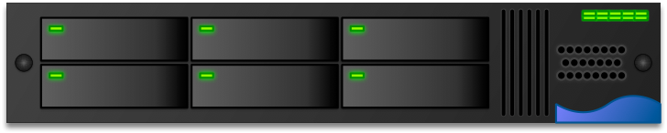
Deploying a Web App
Circa 2008: Manual deployments to private or shared machines
A simple approach that works, but does not scale in:
Number of machines
Number of programs
Size of programs
Frequency of deployments
Write some code
Copy over (s)FTP
Restart server with my changes, make sure it doesn’t crash
Class Server, in CS Department Data Center
Class Server, in CS Department Data Center
Notes:
Back in the old days, when I was a student taking a class like this, and I wanted to take my final project and put it online for my friends to see, the way that I would do it looked something like this: On my computer, I would write some code… Then, copy… Then restart server, make sure doesn’t crash, try to restore from backup if it crashes.
This works, but does not scale. What if I need to deploy to multiple machines? How do I copy the right files and monitor each machine? Eventually one of those machines might crash, and then it needs to be restarted, how do I handle that? Setting up a new machine was not trivial, need to install special packages/dependencies
Number of programs too: especially if others are writing them. How do I assign work to machines in a reasonable way? Does the TA assign students to servers? What if one team uses lots of resources? What if the load is not balanced?
Size of programs: Single app might need to scale beyond resources of a single machine (and beyond what its co-tenants are providing)
Frequency of deployments: we’re working towards continuous deployments

Slide 4
Deploying a Web App
Making it better: automation
Automatically sFTP code to all 50+ machines
Monitor for anomalies
Write a scheduler for machine assignment…
Write some code
New program
New program
New program
New program
New program
New program
New program
New program
New program
New program
Class Server, in CS Department Data Center
Class Server, in CS Department Data Center
Class Server, in CS Department Data Center
Class Server, in CS Department Data Center
Class Server, in CS Department Data Center
Class Server, in CS Department Data Center
Class Server, in CS Department Data Center
Class Server, in CS Department Data Center
Class Server, in CS Department Data Center
Class Server, in CS Department Data Center
Notes:
Lowest hanging fruit: write a script to automatically deploy our app to all of the 50+ machines. Write a dashboard to monitor for anomalies.
Next level of automation: Write a scheduler that will handle machine assignment
Next level of automation: Write a monitor that will detect dead machines and re-schedule tasks

Slide 5
Deploying a Web App
Making it better: Multitenancy
What if the mapping of programs/users to machines is not 1:1?
Example: 5 applications, each get 200MB of RAM, server has 1GB
Problem: What happens if someone’s program goes awry?
Deploy my app
Deploy our apps
Class Server, in CS Department Data Center
Notes:
Most programs have elastic resource needs over their lifetime
Very inefficient to have a 1:1 computer:program mapping
Deploying a new machine can take months: requisition hardware, order, ship, rack, configure
As you scale up, having lots of machines at 20% utilization is a huge waste of resources
Other programs might start using up tons of RAM, or could collide on dependencies (node 14 vs node 15 vs node 6), or could collide on system-wide resources (expect the ability to clear all /tmp files). Security between apps is probably difficult to enforce.

Slide 6
Multi-Tenancy
Virtualization to the rescue
Solution: Each app gets its own Virtual Machine (VM)
OS provides resource limits and quality guarantees per-VM
Each VM runs its own OS - not an efficient use of resources (5x200MB RAM for each app PLUS 5x500MB RAM to run 5 OS’s)
Lightweight containers (e.g. Docker) provide isolation, but run in same OS, less resource utilization
Deploy my app
VM5
VM6
VM3
VM4
VM1
VM2
Deploy our apps
Class Server, in CS Department Data Center

Slide 7
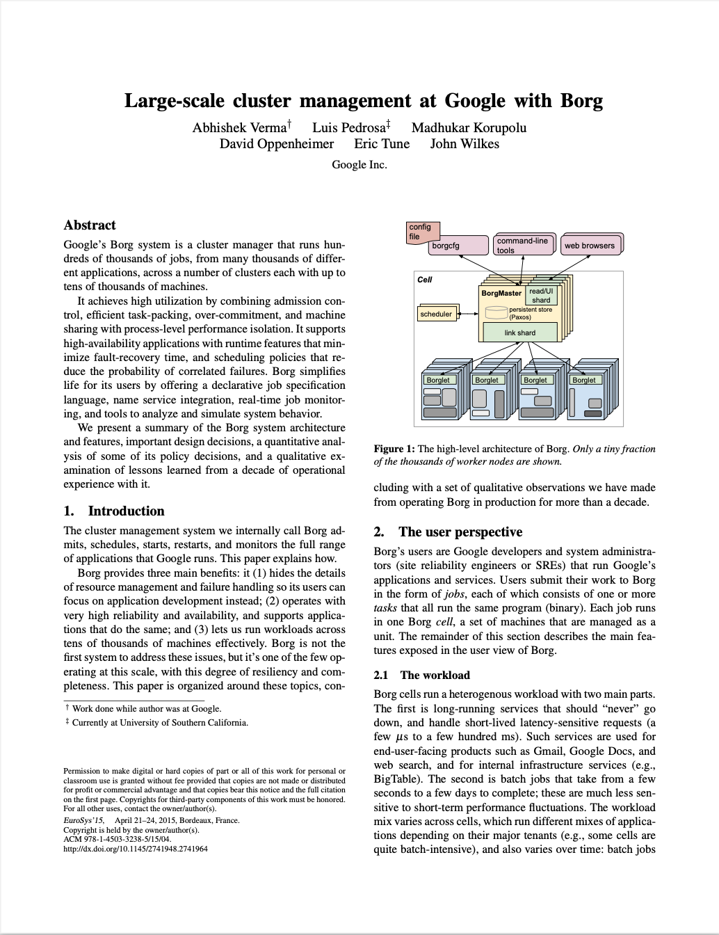
Automating Deployment of Complex Infrastructure
Automation + Multi-tenancy: Kubernetes
My Social Network App
Cache Check
Build friends list
Build Newsfeed
Build Suggestions
Send response
“Give me at least 1 of each of these app services in their own docker containers, and if the load gets above a threshold, spin up more of them”
Suggestions
Some other customer’s service
Cache
Friends list
Newsfeed
Suggestions
Managed by Kubernetes
https://research.google/pubs/pub43438/
Notes:
Kubernetes came out of Google, original internal system was called “Borg”
… Usually these kinds of complex services are not configured by everyday software engineers - there is a lot of very particular knowledge that you need to have. It’s certainly a LOT easier to set up a system like this with Kubernetes than by hand.

Slide 8
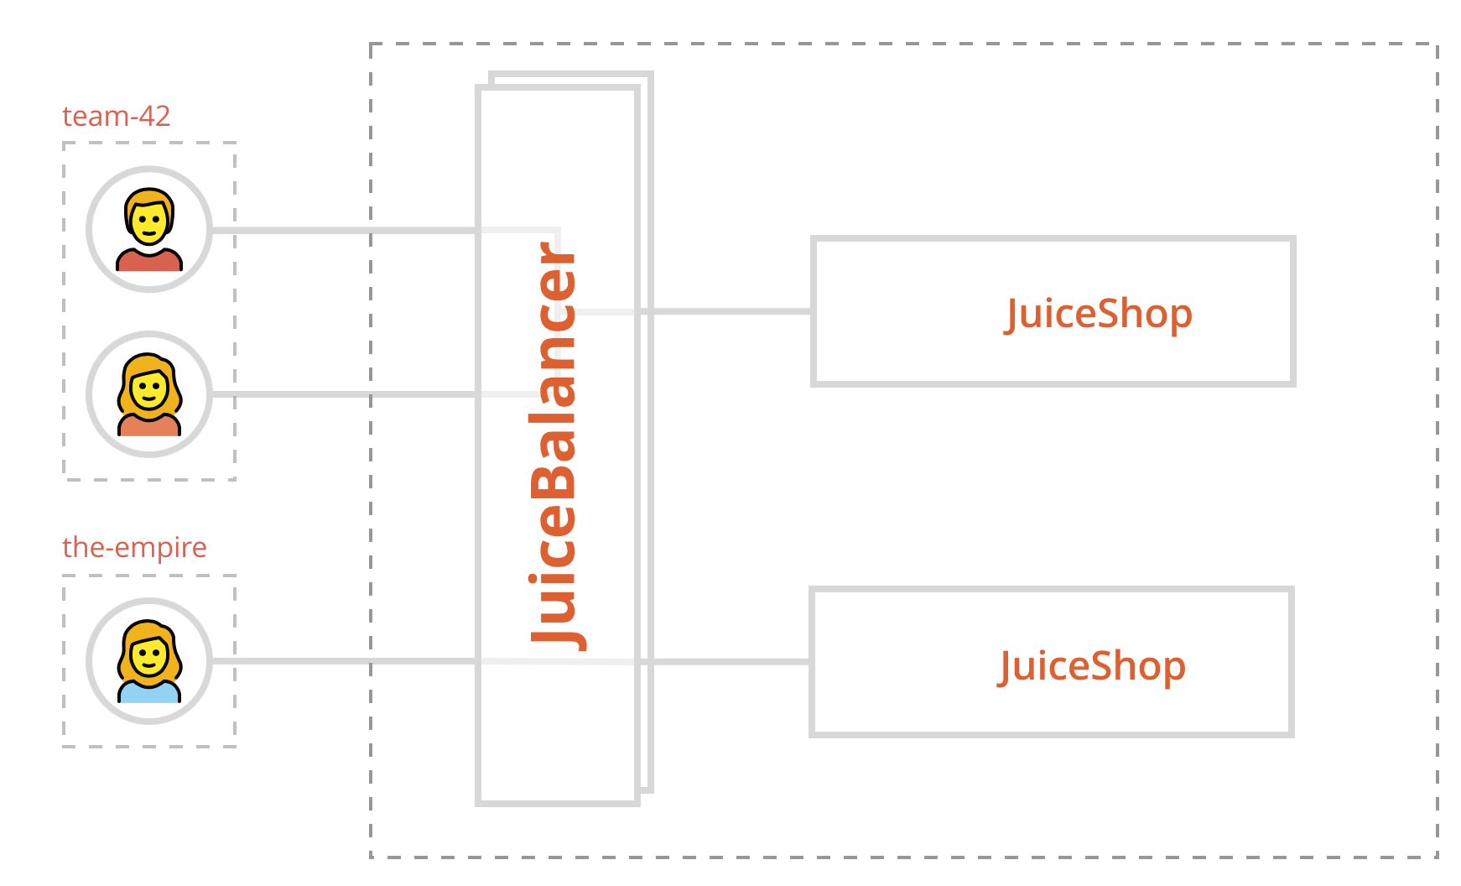
Automation + Multi-tenancy: Kubernetes
Example: Multi-Juicer, the Juice Shop Framework
Each team gets a JuiceShop instance
Each JuiceShop instance is a docker container
Multiple docker containers run on the same VM
A load balancer provisions new containers
As VMs get full, new VMs are booted
https://github.com/iteratec/multi-juicer

Slide 9
Multi-Tenancy
Platform-as-a-service: What if we don’t care about the infrastructure?
I have React, I have ExpressJS, I have Cloud, can I please just have a working app?
Auto deploy
Bill per second
Continuous Integration Server
Platform Provider
Heroku
Netlify
Notes:
For most projects where you DON’T have an engineer whose job it is to set up stuff like that, though, you might be more interested in a different kind of arrangement, where you can…

Slide 10
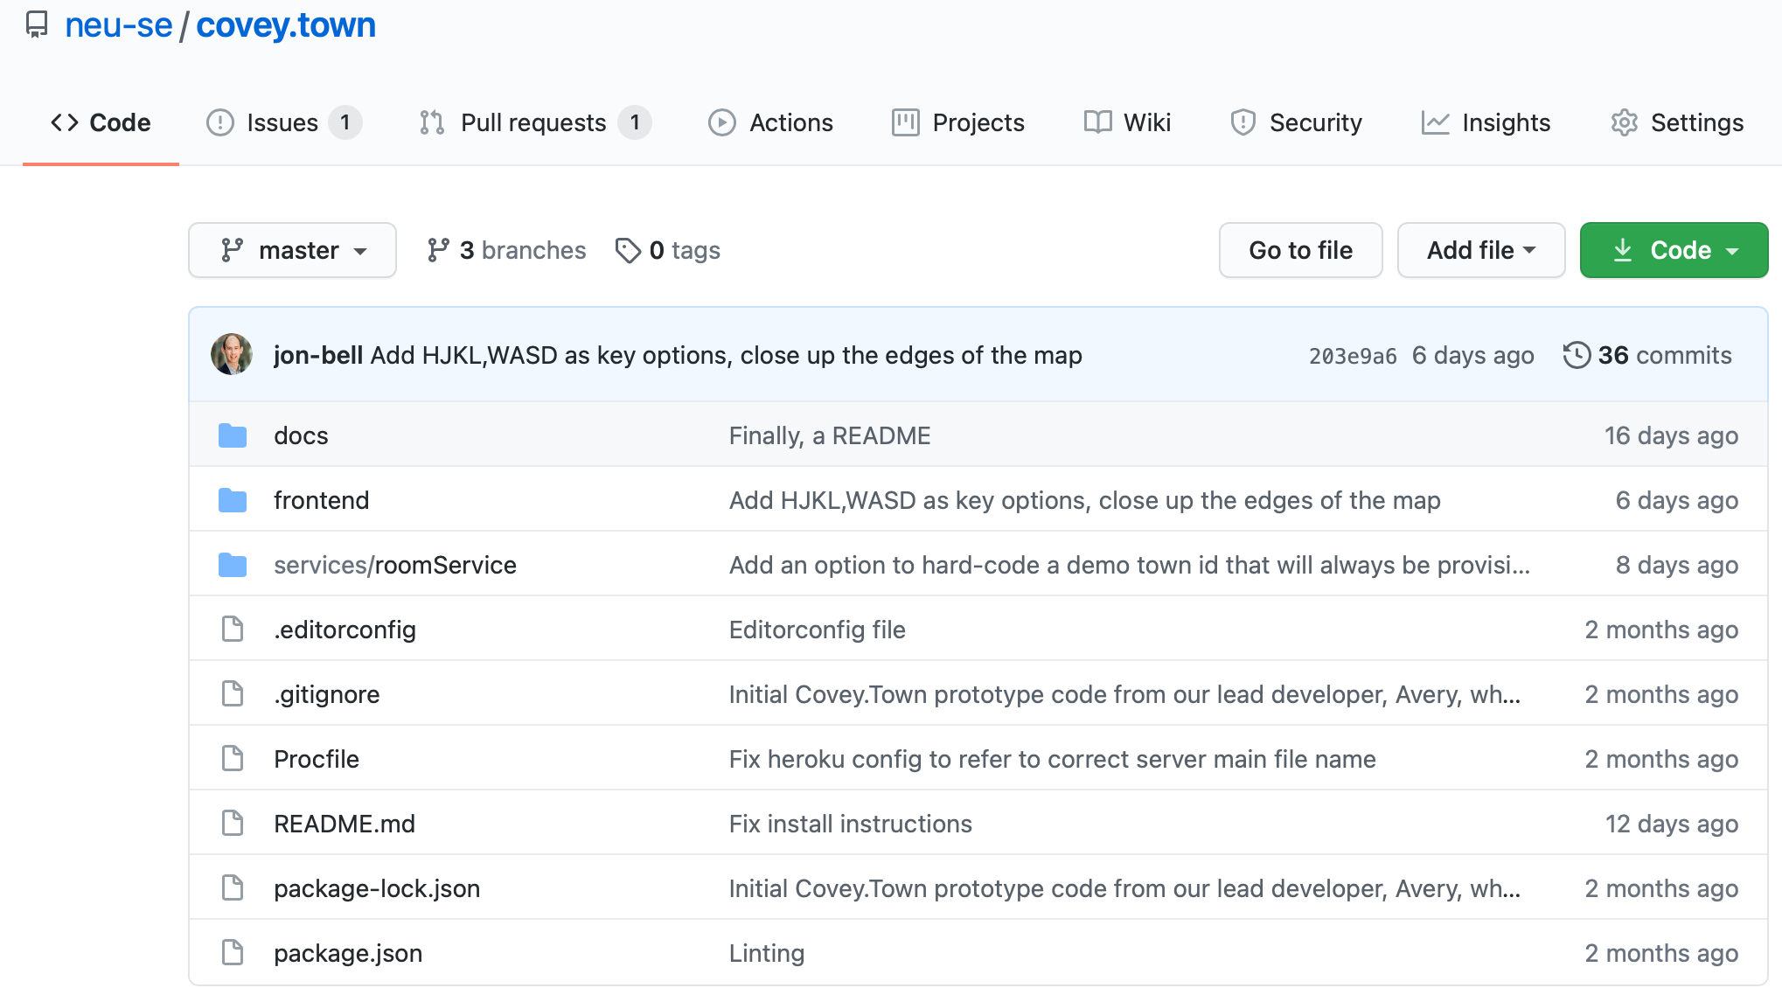
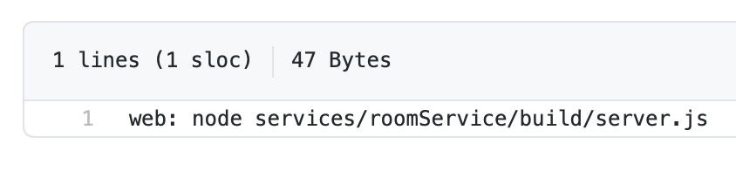
Platform-as-a-Service: Covey.Town Deployment
Heroku
Heroku’s Amazon EC2 VM
Heroku’s Load Balancer
My project runs with NodeJS
After running npm install, run this to make a server
Heroku’s Amazon EC2 VM
Heroku’s Amazon EC2 VM
Covey.Town Towns Service
Other customer
Other customer
Covey.Town Towns Service
Covey.Town Towns Service

Slide 11
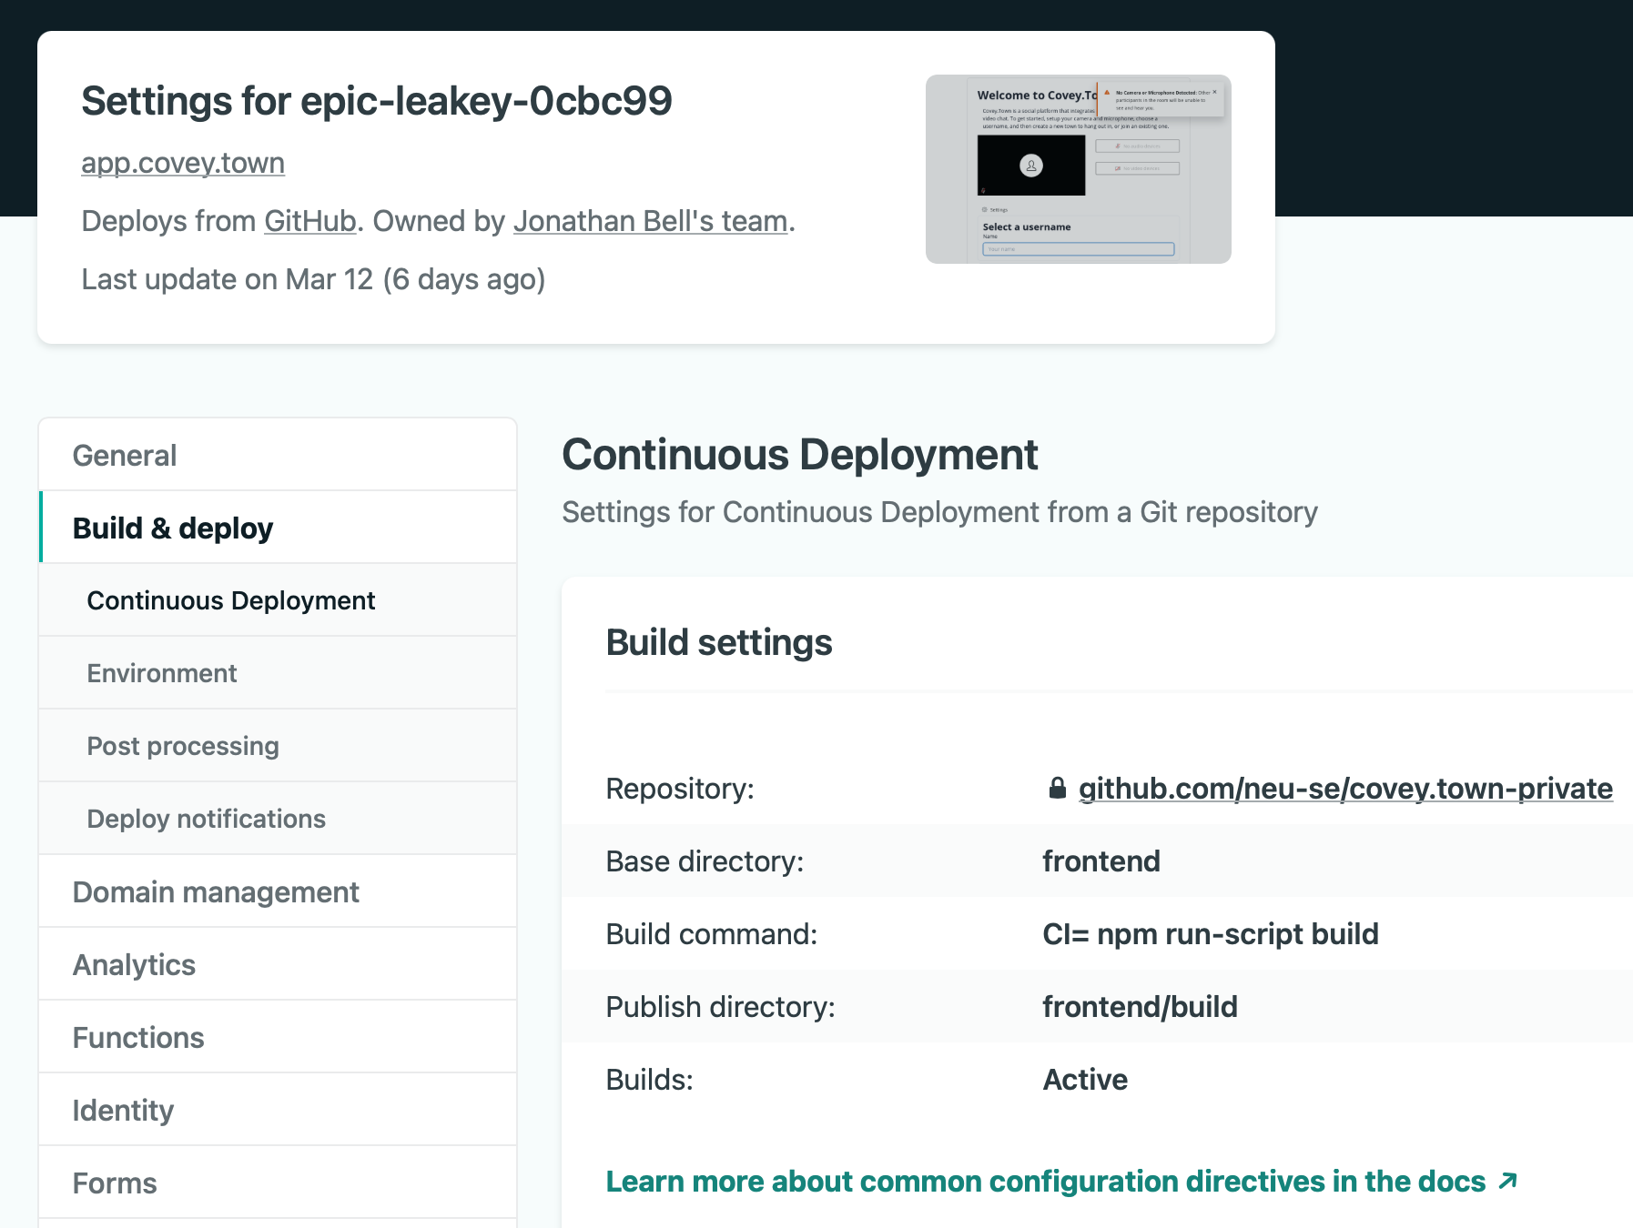
Platform-as-a-Service: Covey.Town Deployment
Netlify
Netlify’s Builder (Proprietary)
Run this command to build my site
Netlify’s Content Delivery Network (Proprietary)
Europe
N America
S America
Asia
Africa

Slide 12
Multi-Tenancy
Functions-as-a-Service: What if we just have a few functions that get called irregularly?
I just need a few functions that grants Twilio tokens! Why do I need to pay for a container?
Bill per millisecond
Serverless Provider
AWS Lambda Google Cloud Functions Azure Functions Cloudflare Workers Apache OpenWhisk
Notes:
Great for low-latency: no need to spin up a custom VM for your function. Don’t store any data - totally stateless

Slide 13
Runtime-as-a-Service
Firebase/Hasura/Parse Platform

Slide 14
Computing Infrastructure
Choosing an abstraction for your application
Centralization vs customization: “machines as cattle vs machines as pets”
How do we manage state?
What is our expected scale?
How much management overhead do we want to take on?
Notes:
Lock-in: Apps will be written based on what’s available. Do you keep state locally? Do you tweak particular VM images? Also, will eventually create big ecosystem of helper services: logging, monitoring ,debugging ,alerting, visualization, on-the-fly analyses and more.
Cattle vs pets: do we mind if the machine we are running on disappears (due to some underlying hardware fault)? Maybe we want it to be auto-migrated somewhere else that it can run safely
State: do we need to store things on each machine running our app? If so, can’t do serverless Scale: Can’t scale to 0 unless using serverless, b/c startup time is too high
Management overhead: do we spin up the machines, or do we not even know/care about them?

Slide 15
Computing Infrastructure
Summary of the options
Deploy VMs: Greatest degree of control, greatest cost, greatest latency
Deploy containers: Better resource utilization
Platform-as-a-service: Minimal degree of control, YMMV with cost
Function-as-a-service: Minimal degree of control, least latency, YMMV with cost
Notes:
The next lesson will cover how we orchestrate our software process to make use of infrastructure like this

Slide 16
This work is licensed under a Creative Commons Attribution-ShareAlike license
This work is licensed under the Creative Commons Attribution-ShareAlike 4.0 International License. To view a copy of this license, visit http://creativecommons.org/licenses/by-sa/4.0/
You are free to:
Share — copy and redistribute the material in any medium or format
Adapt — remix, transform, and build upon the material
for any purpose, even commercially.
Under the following terms:
Attribution — You must give appropriate credit, provide a link to the license, and indicate if changes were made. You may do so in any reasonable manner, but not in any way that suggests the licensor endorses you or your use.
ShareAlike — If you remix, transform, or build upon the material, you must distribute your contributions under the same license as the original.
No additional restrictions — You may not apply legal terms or technological measures that legally restrict others from doing anything the license permits.

